Slide 1
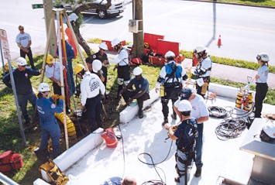
Confined Space Rescue Awareness
An Overview of Confined Space Rescue

Slide 2
Course Objectives
Provide the attendee with the basic understanding of the requirements of Confined Space Rescue so that the attendee can go to the next step of becoming fully trained in Confined Space Rescue.
Review of why Confined Spaces can be dangerous.
Review of the 3 rescue techniques
  Non-entry
  Entry by Others
  Entry by Trained employees from the company
Review the PPE – Personal Protective Equipment that may be required for Confined Space Entry.
Look at Response Time and importance of Response time.
Become familiar with some of the Rescue Equipment that may be required in a CS Rescue.
Review the importance of Lockout Tagout or elimination and removal of potential hazards.
Review key points associated with a Confined Space Rescue Plan.

Slide 3
Disclaimer
“This material was produced under Grant
SH-21000-10-60-F-29 from the Occupational Safety and Health Administration, U.S. Department of Labor. It does not necessarily reflect the views or policies of the U.S. Department of Labor, nor does mention of trade names, commercial products, or organizations imply endorsement by the U.S. Government.”

Slide 4
You have the right to a safe workplace
You have the right to a safe workplace. The Occupational Safety and Health Act of 1970 (OSHAct) was passed to prevent workers from being killed or seriously harmed at work.
The law requires that employers provide their employees with working conditions that are free of known dangers. The Act created the Occupational Safety and Health Administration (OSHA), which sets and enforces protective workplace safety and health standards. OSHA also provides information, training and assistance to workers and employers.
Workers may file a complaint to have OSHA inspect their workplace if they believe that their employer is not following OSHA standards or there are serious hazards.

Slide 5
Workers' rights under the OSH Act
Workers are entitled to working conditions that do not pose a risk of serious harm. To help assure a safe and healthful workplace, OSHA also provides workers with the right to:
  Receive information and training about hazards, methods to prevent harm, and the OSHA standards that apply to their workplace. The training must be in a language you can understand;
  Observe testing that is done to find hazards in the workplace and get test results;
  Review records of work-related injuries and illnesses;
  Get copies of their medical records;
  Request OSHA to inspect their workplace; and
  Use their rights under the law free from retaliation and discrimination.
  http://www.osha.gov/workers.html

Slide 6
This Presentation
This presentation is not designed to certify or train you on Confined Space Rescue.
Confined Space Rescue training and certification should only be completed by the authorization of your company.
This program is designed as an Awareness Training session.

Slide 7
Technical Rescue Awareness
The difference between a hero and a fool is training.
City of Anderson, SC - Fire Department

Slide 8
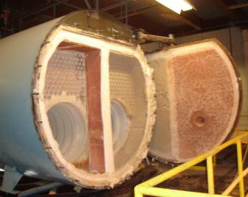
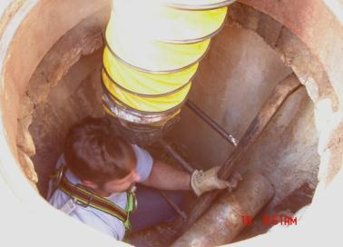
Let’s Review for a Moment

Slide 9
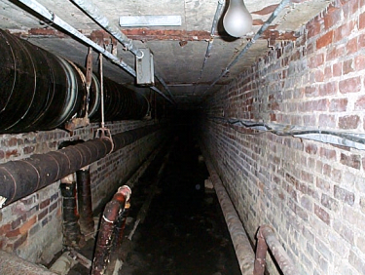
Are Confined Spaces Dangerous?
According to a report from the Canadian Centre for Occupational Health and Safety (www.ccohs.ca):
  Many workers are injured and killed each year while working in confined spaces. An estimated 60% of the fatalities have been among the would-be rescuers.

Slide 10
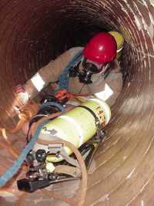
Emergency Rescue
Emergency rescue teams must be available while authorized entrants are in the confined space.
Deaths often occur during rescue. Employees attempt to rescue an entrant without the proper training and then get caught themselves in the confined space.

Slide 11
Rescue Techniques
There are 3 types of rescue techniques:
        Non-entry
        Entry by others
        Entry by Trained employees from the company

Slide 12
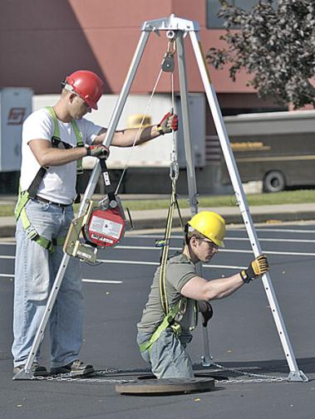
Rescue Techniques
    1. Non-entry – Rescue that is conducted without entry into the confined space. This can be conducted by such means as a rope or winch.

Slide 13
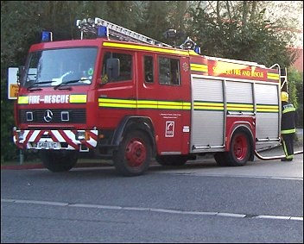
Rescue Techniques
        2. Entry by others – some companies do not have trained personnel for emergency rescue. They depend on others to conduct emergency rescues such as the Fire Department.

Slide 14
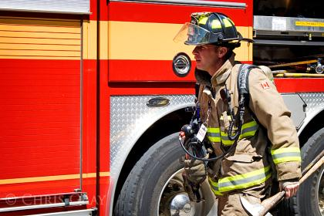
Rescue Techniques
          Entry by others continued – in this case the Fire Department would need:
        To be familiar with the types of confined spaces located in the facility,
        the hazards they may encounter,
        the entry means into the confined spaces,
        the types of rescue equipment to effect a rescue and
        the types of PPE required for any potential rescue.

Slide 15
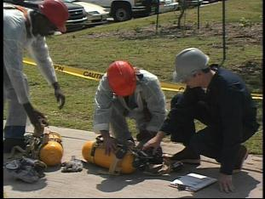
Rescue Techniques
        Entry by Trained employees from the company – some companies have trained personnel within the company to conduct rescues. In this case:
          All members of the team must be specially trained in confined space rescue work,
          The team must have at least one member certified in CPR and first aid,
          All members of the team must be trained in the techniques and equipment for specific confined spaces.

Slide 16
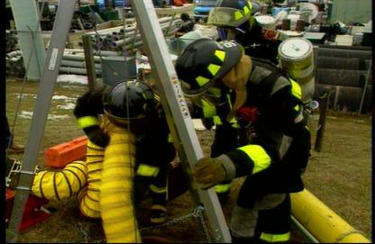
Emergency Rescue
If a rescue is required, the rescue service must close off the area, get authorized entrants out of the space and perform first aid when needed.
It is best to use a retrieval system to bring the employee out of the space. Never enter the space without proper training and unless it is necessary.
Authorized entrants should wear harnesses connected to the retrieval line. The retrieval equipment must be in place before employees enter the permit space.

Slide 17
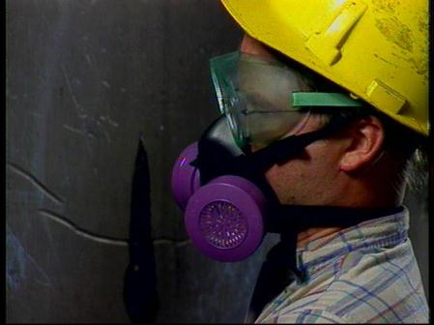
Personal Protective Equipment
One of the most important components of PPE in a confined space is a respirator.
All respirators must be fit tested prior to use.
Cleaning the respirator after each use will help disinfect it.
Before each use of the respirator, it must be inspected to make sure that there are no cracks, holes, signs of wear or loose connections.

Slide 18

Personal Protective Equipment
Other forms of PPE can include hard hats, safety glasses, clothing that protects the torso against chemicals, fires and other hazards, as well as gloves and safety shoes that protect the hands and feet from various hazards.

Slide 19
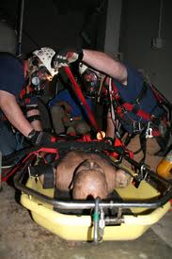
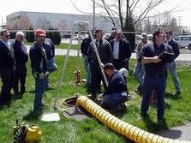
Let’s Take a Look at Response Time

Slide 20
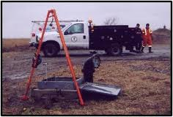
Defining Response Time
Reaction Time
Contact Time
Response Time
Assessment Time
Preparation Time
Rescue Time

Slide 21
Defining Response Time
Reaction Time
  Time between the entrant having a problem requiring rescue and the safety attendant’s recognition that the entrant has problem
Contact Time
  The time taken by the attendant to contact the rescue team.
Response Time
  The time taken by the rescuers to arrive at the scene of the rescue after contact.

Slide 22
Defining Response Time
Assessment Time
  The time taken by a rescue team to size up the problem and determine the strategy to perform a safe, efficient rescue.
Preparation Time
  The time taken by a rescue team to set up for the rescue.
Rescue Time
  The time taken for the team to reach, treat, package, and evacuate the victim from the confined space.

Slide 23
Rescue Equipment
Confined Space Rescue can require a number of types of equipment to effectively and safely perform a rescue.
Let’s take a look at some of the equipment that can be used in confined space rescues.

Slide 24
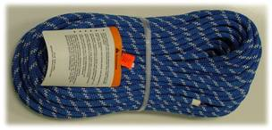
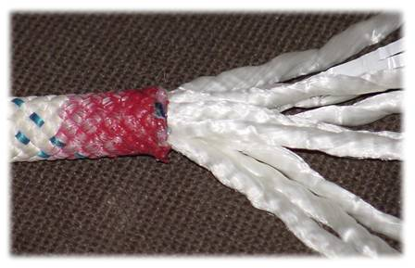
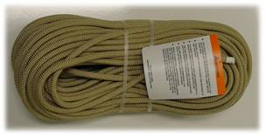
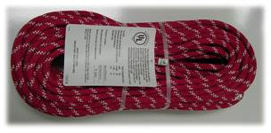
Ropes
Used for
  Primary tool in technical rescue
Vary in construction, material and size
Most common in C.S.
  ½ inch, strength 9,000 lbs.
  Static kernmantle (low stretch)
  Dynamic kernmantle (high stretch)

Slide 25
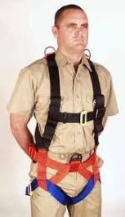
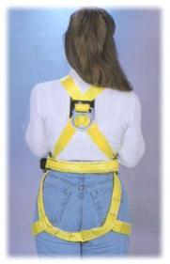
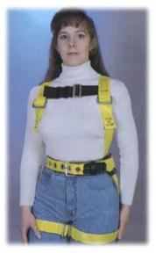
Harness
Used for
  Fall protection
  Confined space rescue
Most common in C.S.
  Flat nylon webbing
  Full body
  Point of attachment in the center of the back at shoulder level

Slide 26
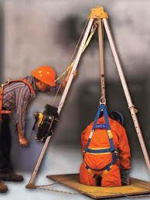
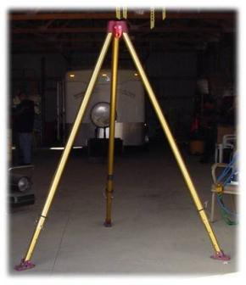
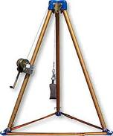
Tripods
Used for
  Access to vertical entry
Most common in C.S.
  9-foot height or greater

Slide 27
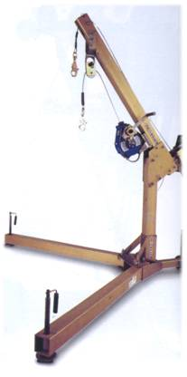
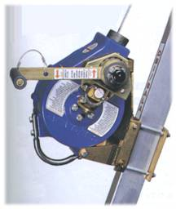
Winches
Used for
  Assist with tripods
Most common in C.S.
  Retractable designated for non-entry rescue
  Certified as a primary lowering device

Slide 28
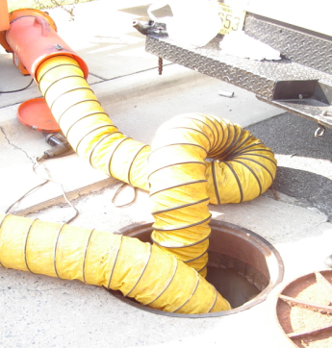
Ventilation Systems
Ventilate, eliminate, or control the space’s atmospheric hazards
Blind or disconnect and cap all input lines so that no hazardous materials can enter the space

Slide 29
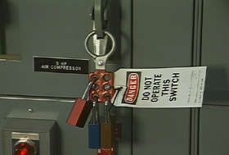
Lockout Tagout
When entrance covers are removed, guard the opening immediately
Remember, you may have to be authorized to perform lockout tagout, depending on company policy.

Slide 30
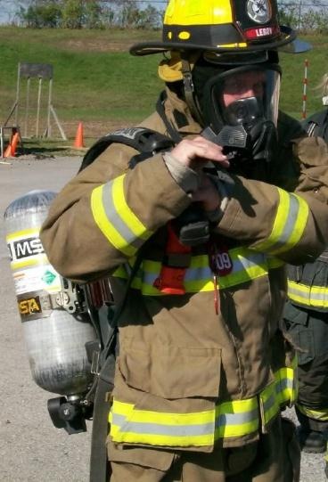
SCBA Units
SCBA (Self Contained Breathing Apparatus) – may be required to enter some confined spaces or to perform a rescue.
There are special guidelines that must be followed prior to wearing an SCBA.

Slide 31
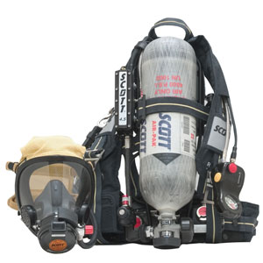
SCBA Wearer Requirements
In order to wear a SCBA a rescuer would have to provide a Respirator Clearance or Physician Approval prior to wearing a SCBA.
After the Respirator Clearance the Rescuer would have to be Fit Tested for the SCBA Unit.

Slide 32
Rescue Equipment
As you can see, there are numerous types of rescue equipment that is available to assist with rescues.
Each confined space must be evaluated to determine what type of equipment is required to perform a rescue should it become necessary.
If outside resources, such as the Fire Department, are utilized to perform confined space rescues, the agency should be given access to your facility to enable them to:
  Be aware of the types of confined spaces you have
  Determine the types of equipment and rescue techniques they will need to perform a rescue

Slide 33
Commanding the Confined Space Rescue
If you are part of a rescue team at your facility, you must be familiar with your rescue plan. Let’s discuss some key points associated with a rescue plan and points that need to be considered to keep rescuers safe.
A confined space rescue will still have roles that must be filled during the rescue.
A Rescue Team will have an Incident Command Supervisor.

Slide 34
Roles
Remember that the same roles apply in a confined space rescue that apply to a normal confined space entry.
  Entry Supervisor
  Attendant
  Entrant, Primary
  Entrant, Standby
With a confined space rescue, there is an additional role that is assigned -
  Incident Commander

Slide 35
(Incident Commander)
IC Priorities
A Confined Space Rescue Scene will have a Incident Commander. The priorities of the IC are mainly:
      1. Responder safety
      2. Safety of the victim
      3. Assessment of the situation
      4. Type of Rescue
      5. Development of the rescue plan
      6. General public control and safety
  Must keep in mind that 60% of fatalities are would be rescuers

Slide 36
1. Responder Safety
Assessment of the situation and confined space
  What PPE will be required
  Obtain air monitoring samples
  Assess hazards
  Characteristics of space
Hazard Mitigation
  Avoid the hazard
  Remove the hazard
  Control the hazard
  Use personal protective equipment

Slide 37
2. Safety of the Victim
Is the victim conscious?
Is the Victim unconscious?
Will medical attention be required?
Will medical personnel need to be notified?
What type of rescue equipment will be required to safely remove the victim?
Is there a timeline associated with the rescue because of the condition of the victim?

Slide 38
3. Assessment of the Situation
Hazards Present
  Atmospheric
  Energy Sources
  Entrapment
  Fall
  Fire / Explosion
  Hazardous Material
Hazard Mitigation
  Risks associated with the rescue
  Length of time to implement any hazard controls

Slide 39
3. Assessment of the Situation
Distance required for rescue
Rescue Problem within Capabilities of the Department / Team

Slide 40
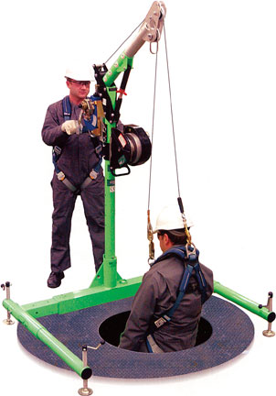
4. Type of Rescue
Offensive ( rescue)
  Are lives at risk
  Complexity of the rescue
  Hazards are known and controllable
  Resources are available for the rescue
  Incident stabilization prompt and probable
Defensive ( body recovery )
  No life probability of victim
  Complexity of the rescue
  Hazardous conditions still exist
  Resources available or unavailable
  Stabilization unlikely

Slide 41
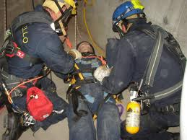
5. Development of the Rescue Plan
Survival time of the victim
Confined Space Characteristics
  Type
  Function
  Configuration
  Construction
  Size
  Entry Points (size, number, location)
Assignment of roles
Sufficient Personnel (numbers, experience, training)
Appropriate equipment, Apparatus, Material
Communication & Communication Equipment
Interagency Coordination

Slide 42
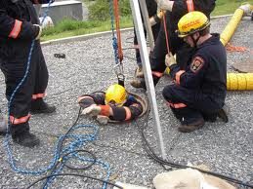
5. Development of the Rescue Plan
Ventilation of space
Monitoring of space
Air supply for rescuer’s if required
Control of all sources of energy and engulfment hazards - Including LOTO, Blocking, etc.

Slide 43
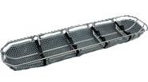
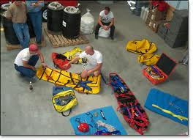
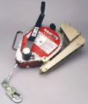
5. Development of the Rescue Plan
Rigging - will need to determine the types of rescue equipment needed.
  Slings
  Rescue Basket
  Ropes
  Victim Stabilizers
  Winche/s

Slide 44
6. General Public Control and Safety
Perimeter Control – Depending on type of situation:
  May need police
  Barrier tape, ropes, barricades
  Controlling traffic
  Limiting access to the rescue area to assigned personnel

Slide 45
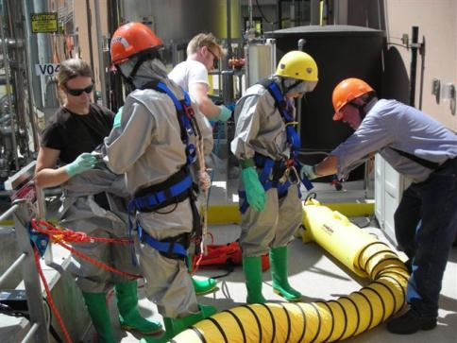
Rapid Intervention Team
Provides safety backup
Dressed in same PPE as entry, ready to go
Cannot be assigned to another task during the rescue

Slide 46
After the Rescue
Debrief
Re-supply
Documentation
Post incident analysis

Slide 47
F-A-I-L-U-R-E
Failure to understand the environment
Additional medical issues not considered
Inadequate rescue skills
Lack of teamwork or training and experience
Underestimating the logistics of the incident
Rescue verse recovery mode not considered
Equipment not mastered

Slide 48
What’s Next?
What do you need to do once you get back to your facility?

Slide 49
Next Steps
If you are part of a rescue Team:
  Obtain a physician’s approval or clearance to wear a SCBA.
  Get fit tested.
  Know your rescue plan.
  Become familiar with the confined spaces that you have in your facility.
  Know what equipment will be necessary for each Confined Space, should a rescue be necessary.
  Know the hazards associated with each confined space.
  Know how to eliminate the hazards associated with the confined spaces.
  Practice, practice, practice
  Retrain when new confined spaces are added or when something regarding an existing confined space changes.

Slide 50
Conclusion
The entry supervisor needs to ensure that the confined space operations conform to the permit. They should remove unauthorized personnel from the area and keep them from entering the space. The entry supervisor terminates and cancels the permit at the right time.
Make sure each hazard is identified and controlled before entering a confined space.
Fully understand the requirements of a confined space rescue:, including commanding the confined space rescue and control of the area.
Always report any concerns you may have regarding confined spaces.
Emergency rescues should only be made by trained personnel or a rescue service.

