Slide 1
PERSONAL PROTECTION EQUIPMENT

Slide 2
COURSE OBJECTIVES
Have a basic understanding of:
The purpose and basic concepts of PPE
When PPE is necessary
Different kinds of PPE available
How to wear and maintain PPE
Limitations of PPE
How PPE can protect from on-the-job hazards

Slide 3
SELECTION OF PPE
Hazard Evaluation
  Identify hazards
  Determine route of entry
  Quantify hazards
Engineering Controls
Select the appropriate PPE
  Consider flexibility, dexterity, mobility
  Consider type of material required
  Potential for heat stress, etc.

Slide 4
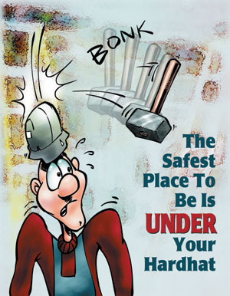


HEAD PROTECTION

Slide 5
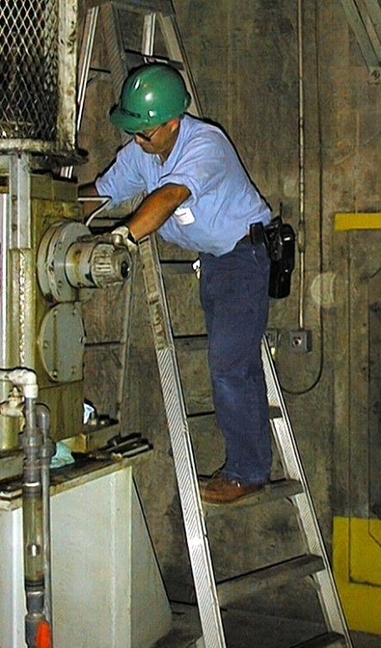
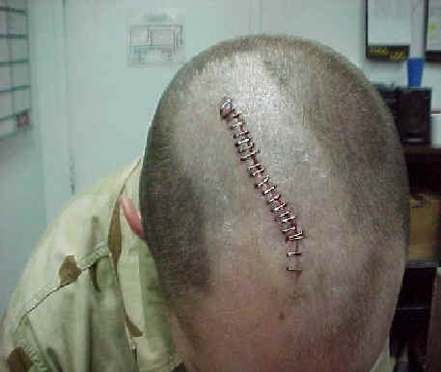
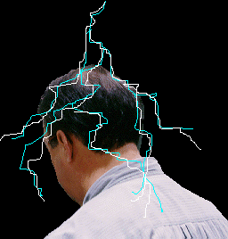
HEAD PROTECTION (cont.)
Resists penetration and absorbs shock
Maintain 1 1/2 inch clearance
Inspect daily
Take out of service and replace when
damaged
To be worn when:
there is the danger of falling or flying objects
working near exposed electrical equipment
near moving machinery

Slide 6
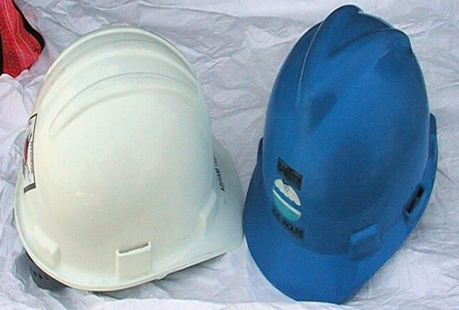
PROTECTIVE HATS
Type I - Top
Type II - Top & Sides
Class G - Conductive - 2,200 volts
Class E - Electrical - 20,000 volts
Class C - General purpose

Slide 7
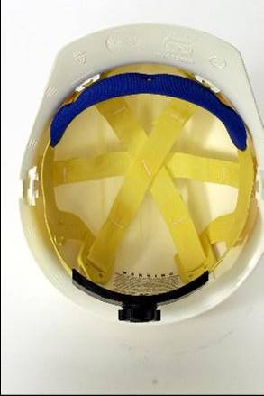
Hard Hat Suspension
(what’s under the shell)
Inspect suspension before every use. Look for cracked, torn or frayed straps. Replace suspension when damage or defects are detected.
Suspensions will deteriorate over time from exposure to sunlight and chemicals, perspiration and hair oils.
The normal service life of the suspension is about one year of regular use. The suspension may last longer with intermittent use.
Notes:
“Perspiration from daily use of a hard hat during hot weather may cause the suspension to deteriorate in less than a year. Replace the suspension when needed.”

Slide 8
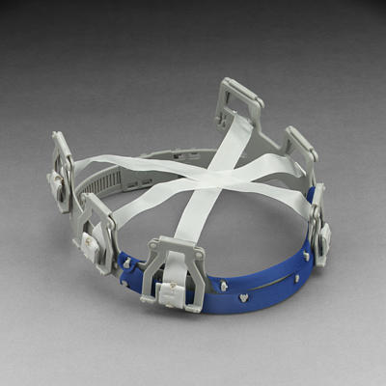
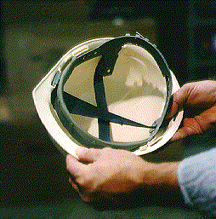
Hard Hat Suspension (cont.)
Don’t mix different manufacturer suspension types and hard hats.
Replacement suspension harnesses must be from the same manufacturer and for the same model of hard hat.
Don’t wear a hard hat backwards unless you rotate the suspension.
Notes:
“Hard hats have either a 4-point or 6- point suspension system as shown in the two photos. Get replacement suspensions from (name person). Most newer hats have a pivoting suspension adjustment knob that allows you to swivel a hat shell from front to back and leaves the suspension in its most protective configuration.”

Slide 9
Hard Hat Replacement
Inspect headwear before each use for any visible signs of dents, cracks, gouges, penetration, chalking, loss of gloss or any other signs of damage that might reduce the degree of safety originally provided.
Replace hat when hairline cracks start to appear.
Replace hat that has been struck by a forceful object, even if no damage is obvious.
Notes:
“Under normal use, hardhats will last two to five years. Our company policy is supply you with a new hard hat every (specify) years. Get replacement hardhats from (name person). Remove or destroy any hard hat if it’s protective abilities are in doubt.”

Slide 10

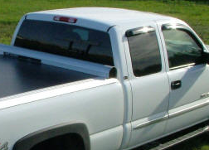
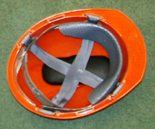
Use of Hard Hats
Don’t use paint, solvents, gasoline, chemicals, or harsh cleaning materials on the shell.
Don’t transport headwear in rear windows of vehicles since sunlight and extreme heat will weaken it.
Don’t put anything in the space between the suspension and the shell.
Notes:
“Paint, solvents chemicals and harsh cleaning chemicals will weaken the plastic, make it more susceptible to cracks and reduce electrical resistance. Paint will also hide cracks that may develop. Stickers are O.K. Since the space between the suspension and the shell acts as a shock absorbent, objects in that space would likely transfer the force of an impact to the head (illustrated by the glasses case inside the orange hard hat photo.)”

Slide 11
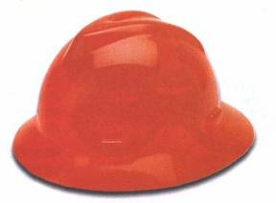
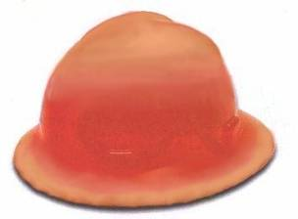
Evidence of UV Deterioration
Plastic hats are unserviceable if:
There are visible cracks,
There is discoloration due to ultraviolet light (sun light)
If squeezing the sides of hardhat causes a popping sound (indicates plastic is breaking down – doesn’t have resiliency)
As it comes from the store
After too many UV rays

Slide 12
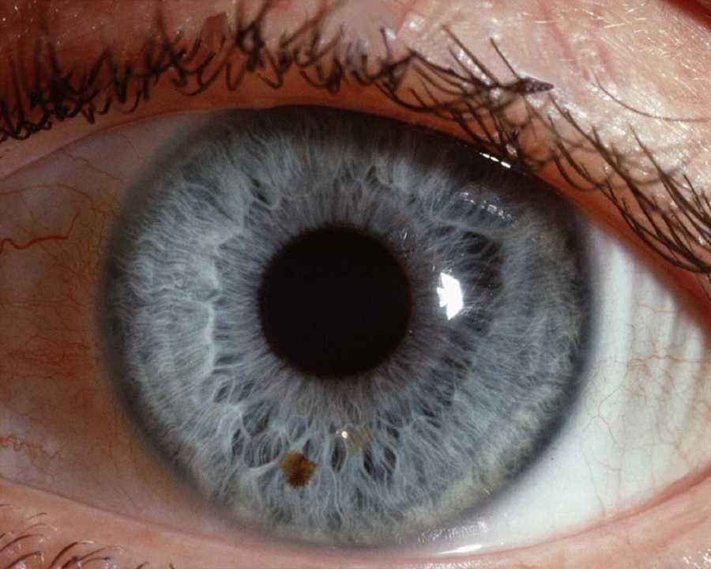
Eye Protection

Slide 13
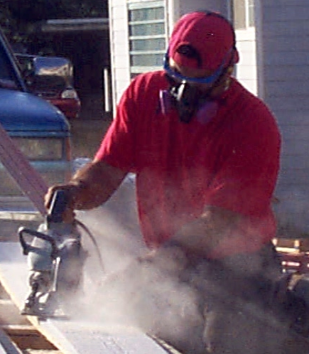
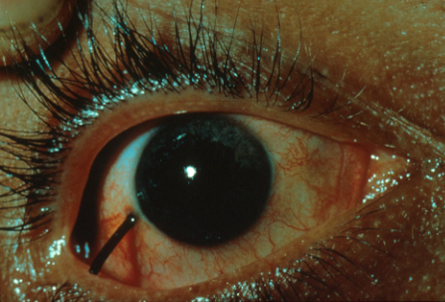

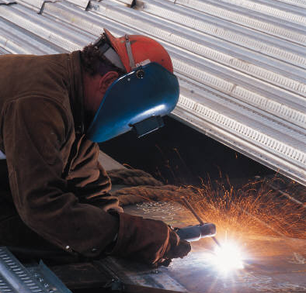
Types of Eye Hazards
Particles and dust
Flying objects
Chemicals
Harmful light radiation – ultraviolet, lasers, infrared
Notes:
Eye hazards vary depending on the type of work you do, but these are the main categories.

Slide 14
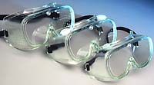



TYPES OF EYE PROTECTION
Safety Glasses
Safety Goggles
Face Shield
Welders/Chipper Goggles
Welding Shields
Prescription Eyewear

Slide 15
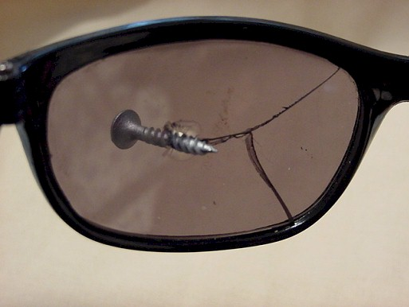
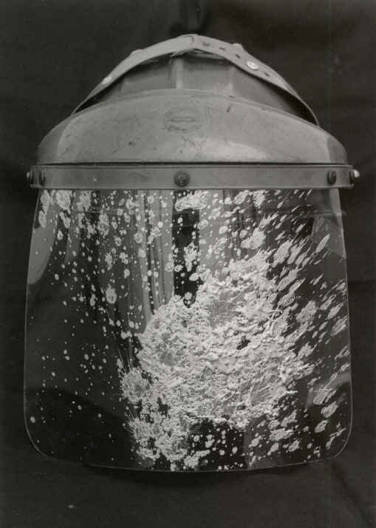
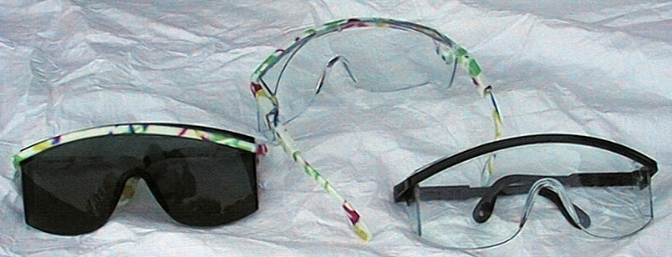
CARE OF EYE PROTECTION
Clean with warm soap and water, air dry
Replace if scratched or otherwise damaged
Emergency Eyewash

Slide 16
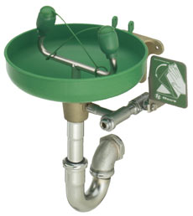
Emergency Eyewashes
An eyewash station is required for potential eye exposure to:
corrosives – acids, caustics
strong irritants – many chemicals
toxic chemicals - pesticides
Notes:
“Eyewashes must be located within 10 seconds or 50 feet of the location where a splash to eyes could occur. Eyewashes are required for strong irritants that cause irritation for a day or more. In agriculture, eyewashes are required for anyone handling pesticides. Other chemicals can be toxic enough to require an eyewash.”

Slide 17




Hand Protection
Notes:
1910.138

Slide 18
WORKPLACE ACCIDENT &
INJURY STATISTICS
Back 24%
Hands & Fingers 17%
Legs 13%
Arms 11%
Head, Face, And Eyes 9%
Trunk 10%
Feet And Toes 7%
All Others 9%

Slide 19
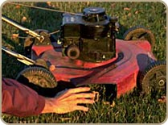
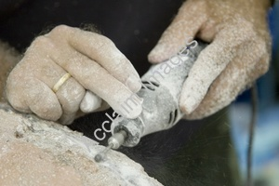
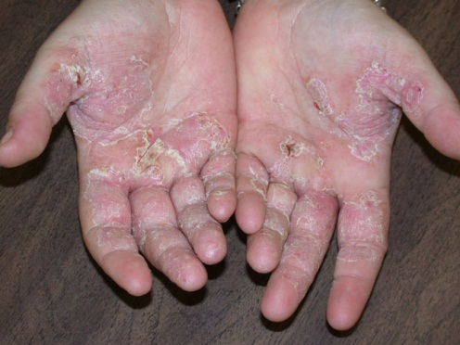
HAND AND ARM
PROTECTION
Chemicals
Abrasive or corrosive materials
Electric equipment, high voltage
Hot spots
Hand tools
Pinch points
Rotating machinery
Automated machinery

Slide 20
GLOVE SELECTION
Based on:
Performance characteristics
Conditions of use
Duration of use
Other hazards present, such as moving machinery

Slide 21

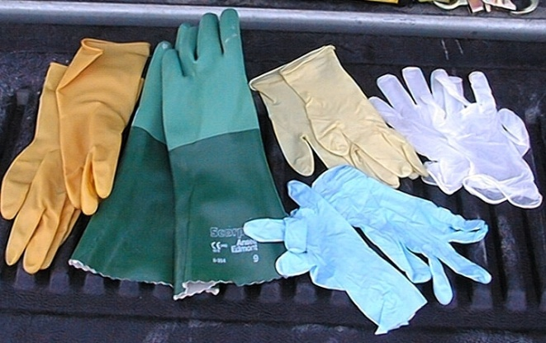
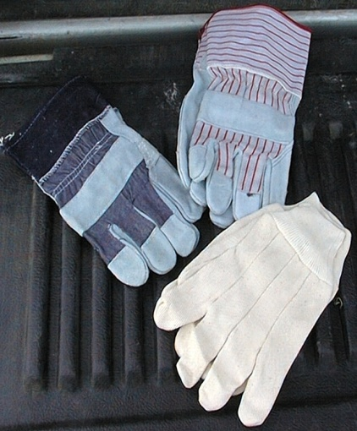
AVAILABLE GLOVES AND CARE
Disposable Gloves
Fabric Gloves
Leather Gloves
Chemical Protective Gloves
Thermal Gloves
Care of Gloves

Slide 22
HAND PROTECTION
BARRIER CREAMS
Water-repellant cream
Sunscreen
Solvent repellent cream
  Apply to clean & dry hands
  Reapply frequently
  Wash off after work, before eating, and when dirty

Slide 23
Before you use…
Use the proper glove for the task.
Remove rings & bracelets.
Do not wear gloves if they can be caught in machinery.
Ensure proper fit - Gloves too large or too small can lead to injuries
Check gloves for wear and damage.

Slide 24
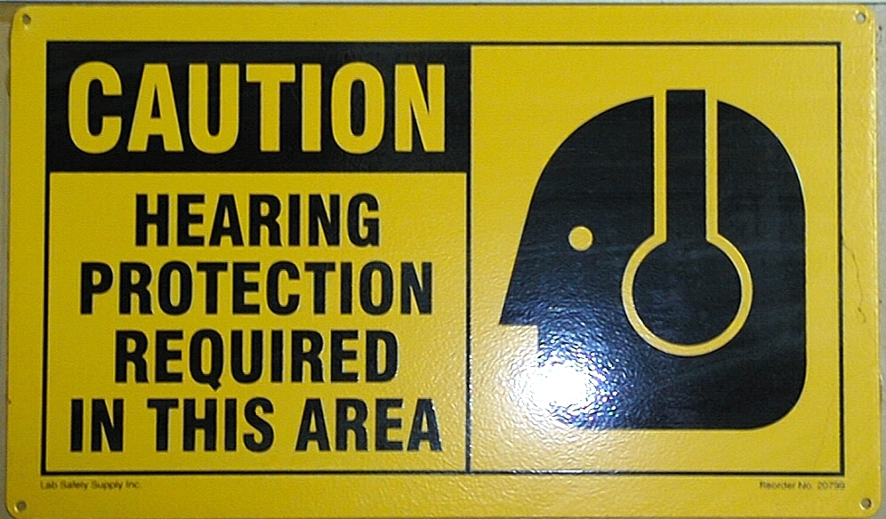
HEARING PROTECTION
Worn in high noise areas (90 dBA)
85 dBA inclusion in the HCP is mandatory
Earplugs
Earmuffs
Care

Slide 25
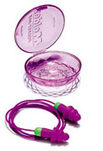
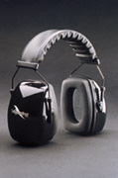
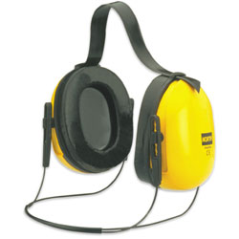
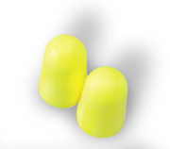
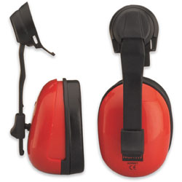
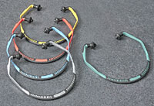
HEARING PROTECTION
Pre-molded
Neck band
Muffs
Formable
Bands
Cap mounted

Slide 26
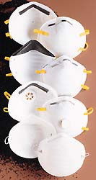
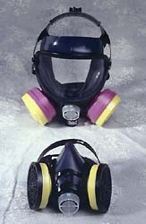

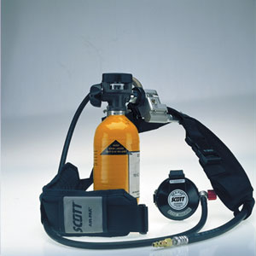
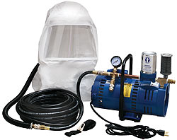
RESPIRATORY PROTECTION
AIR PURIFYING RESPIRATOR
SUPPLIED AIR RESPIRATOR
DISPOSABLE RESPIRATOR

Slide 27
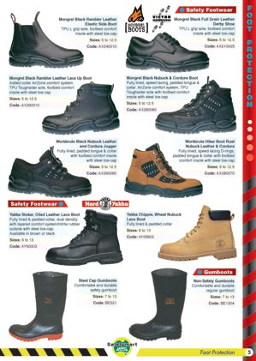
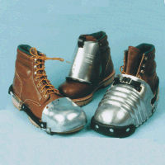
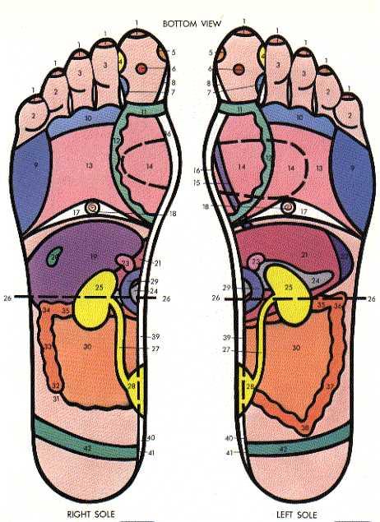
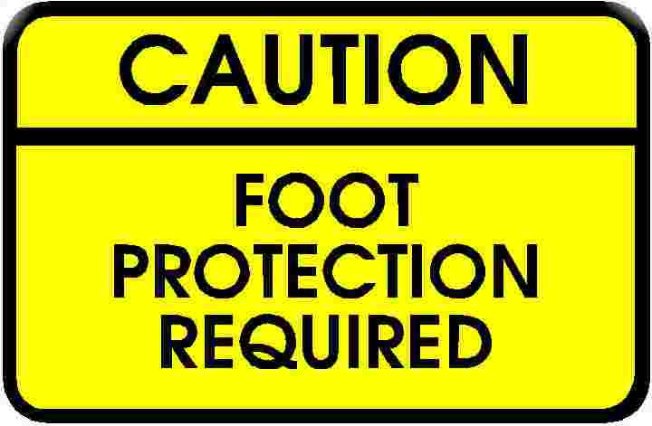
FOOT PROTECTION

Slide 28
FOOT PROTECTION
For protection of feet from falling or rolling objects, sharp objects, molten metal, hot surfaces, and wet slippery surfaces workers should use appropriate safety shoes, or boots.

Slide 29
TYPES OF FOOT PROTECTION
Steel-reinforced shoe
Safety boots
Neoprene or nitrile boots
Gaiter style boots
Electrical boots
Care of Foot Protection

Slide 30
What Should I Know When I Buy Footwear for Work?
The inner side of the shoe must be straight from the heel to the end of the big toe.
The shoe must grip the heel firmly.
The forepart must allow freedom of movement for the toes.
The shoe must have a fastening across the instep to prevent the foot from slipping when walking.

Slide 31
What Should I Know When I Buy Footwear for Work? (cont.)
Do not expect that footwear which is too tight will stretch with wear.
Have both feet measured. Feet normally differ in size.
Buy shoes to fit the bigger foot.
Buy shoes late in the afternoon when feet are likely to be swollen to their maximum size.

Slide 32
LEG PROTECTION
Full Leg Protection
Knee Protection
Shin Protection
Ankle Protection

Slide 33

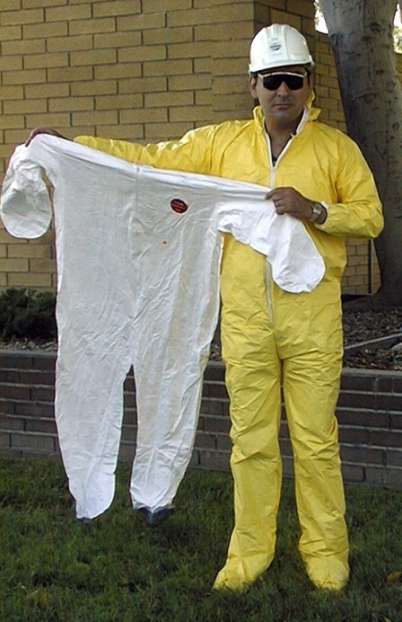

FULL BODY PROTECTION
Blue Uniforms
Uncoated Tyvek coveralls
PVC coated Tyvek coveralls
Rain gear
Thermal Protection

Slide 34
CARE OF PPE
Keep all protective equipment clean
Ensure PPE is not scratched or damaged
Replace when damaged

Slide 35
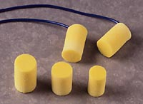
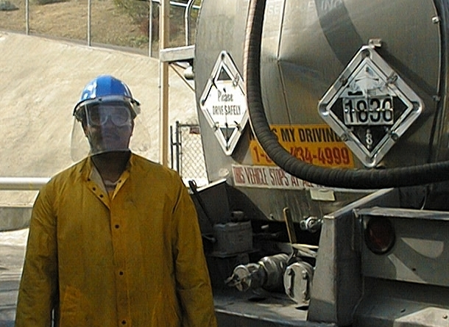

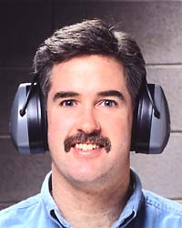
WEAR YOUR PPE AT WORK

Slide 36
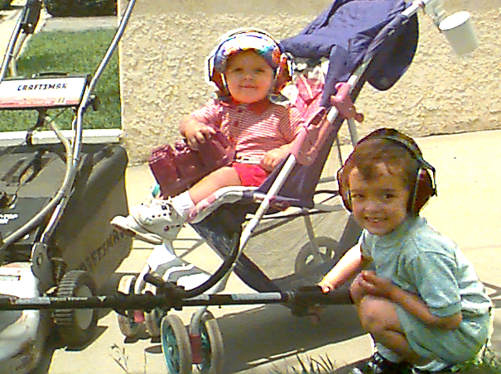
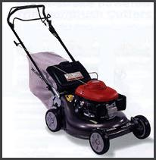
WEAR YOUR PPE AT HOME

