Slide 1
RESPIRATORY PROTECTION

Slide 2
Topics of Discussion
Responsibilities
Respiratory System
Selection of Respirators
Air Purifying Respirators
Supplied Air Respirators
Requirements for wearing respirators
Maintenance and Care

Slide 3
Responsibilities
Program Administrator
Managers and Supervisors
Employees

Slide 4
Program Administrator
Conduct exposure assessments
Identify tasks with respirator use
Select respirators
Annual review of program
Periodic field assessments
Conduct training
Maintain communication with Section Head

Slide 5

Managers and Supervisors
Implement the Respirator Program
Ensure employees are trained, fit tested and have current medical clearance.
Maintain respirator supply inventory
Ensure respirators are maintained properly

Slide 6

Employees
Follow program requirements
Complete training, fit testing and medical clearance
Maintain respirators in good condition
Inform management or EH&S of any problems associated with respiratory protection

Slide 7
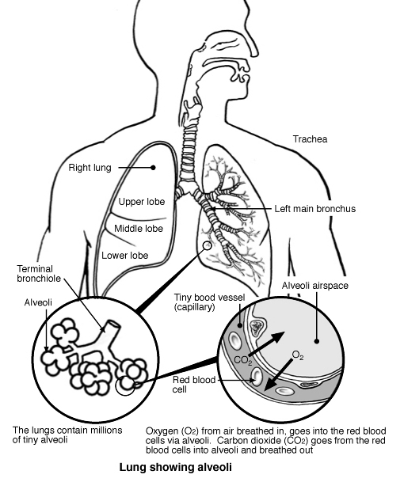
Respiratory System
Nose
Throat
Trachea
Bronchi
Lungs
Alveoli

Slide 8
Respiratory Hazards
Toxic
Dusts, fumes, and mists (particulate)
Gases and vapors
Oxygen deficiency or enrichment atmospheres
Oxygen level in atmosphere must be between 19.5% and 23.5%
Immediately Dangerous to Life and Health (IDLH)
An atmosphere that poses an immediate threat to life, would cause irreversible adverse health effects, or would impair an individual’s ability to escape from a dangerous atmosphere.

Slide 9
Why are respirators NOT the first choice?
Respirators have MAJOR limitations. They are neither foolproof nor fail-safe.
They can leak, wear out, or be the wrong kind.
They can be hot, uncomfortable, and make it hard to see and communicate.
They can be hard to breathe through, and people with heart or lung problems can not wear them.
Most people really don’t like to wear them, and they are too easily removed in contaminated air.

Slide 10
OSHA Permissible Practice
The primary means to control occupational diseases caused by breathing contaminated air is through the use of feasible engineering controls, such as enclosures (sand-blast cabinet), process change (vacuum verses dry sweep), ventilation (spray booth), or substitution of less toxic materials (garnet rather than silica sand).
When effective engineering controls are not feasible, or while they are being instituted, appropriate respirators shall be used.

Slide 11
Employee Exposure
OSHA Permissible Exposure Limit (PEL):
The legal airborne concentration of a substance that workers can be exposed to day after day.
Exposure to a concentration of an airborne contaminant that would occur if the employee were NOT using respiratory protection.

Slide 12
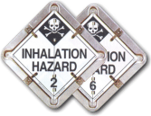
Selection of Respirators
Based upon the hazards in the work space
Must wear approved respirators
EH&S makes the final decision on respirator selection

Slide 13
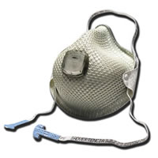
Air Purifying Respirators
Half face piece
Full face piece
Powered Air purifying
Filtering Facepiece Respirators (Disposable/single use/dust mask)

Slide 14
Criteria for Using APRs
Known airborne contaminants
Concentrations within range of respirator
Adequate oxygen
Adequate warning properties

Slide 15
Protection Factors
Half 10
Full 50
PAPR 50 (half) 1000 (full)
PF x PEL = Maximum Use Concentration

Slide 16
Filters Classifications

Slide 17
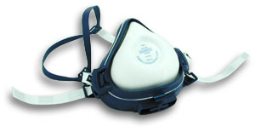
High Efficiency Particulate Air Filter (HEPA)
Filter that is at least 99.97% efficient in removing monodisperse particles of 0.3 micrometers in diameter.
Equivalent NIOSH 42 CFR 84 particulate filters are the N100, R100, and P100 filters.

Slide 18
Respiratory Cartridge Color Coding
P100 (particulates) - magenta
Organic vapor (solvents) - black
Ammonia- green
Acid gas (sulfuric acid, for example) - white
Acid gas and organic vapor - yellow
Organic vapor & particulates - combination
These are some commonly used chemical cartridges

Slide 19
Respirator Cartridges
Types of Cartridges
Dust cartridges filter out dust only.
Chemical cartridges trap different types of chemicals, but not dust.
Cartridges are color-coded for the type of chemical or dust.
Notes:
“Cartridges are colored-coded to show what substance they should be used for. Dust cartridges are purple, black is for solvents or “organic vapors”, green is for ammonia, other colors are for other chemicals. Cartridges are also labeled for the chemicals for which they provide protection. There are no cartridges for carbon monoxide”

Slide 20
Filter Selection
There is no “universal filter.”
No cartridge, canister, or filter will protect against everything!

Slide 21
Atmosphere-Supplying Respirators
Oxygen below 19.5%
Unknown contaminants
Unknown concentration of contaminants
Concentrations are IDLH

Slide 22
Supplied-Air Respirators
Full facepiece with remote compressed air cylinder and high pressure hose.
No more than 300 feet of high pressure hose.
Must deliver at least 8 cubic feet per minute of air for each person on the system.

Slide 23
Self-Contained Breathing Apparatus
Inspect prior to use.
The cylinder must be full and the SCBA in working condition before stored for later use.
Ensure availability of spare cylinders for use in emergencies.
Clean and inspect monthly for emergency use.

Slide 24
Protection Factors
SCBA - 10,000 x PEL
Air line – 50 x PEL (half-face)
  1,000 x PEL (full-face)

Slide 25
Escape Respirators
Designed for leaving a hazardous area.
Five to fifteen minutes of air
Inspect monthly
Ensure escape respirators are easily accessible

Slide 26
Fit Testing
Before an employee uses any respirator with a negative or positive pressure tight-fitting face piece, the employee must be fit tested with the same make, model, style, and size of respirator that will be used.

Slide 27
Qualitative Fit Test (QLFT)
A pass/fail fit test to assess the adequacy of respirator fit that relies on the individual’s response to the test agent.

Slide 28
Quantitative Fit Test (QNFT)
An assessment of the adequacy of respirator fit by numerically measuring the amount of leakage into the respirator.
Notes:
This is the ADOT preferred method of fit testing, but irritant smoke (QNFT) may be substituted if necessary.

Slide 29
Fit Testing
Uses a qualitative fit test for all
tight-fitting respirators
Provide enough choices to ensure a comfortable fit
Frequency
Reasons for more frequent fit tests

Slide 30
Facial Hair & Eyeglasses
Respirators must fit properly to prevent leaks around the edges.
Eyeglass inserts can be worn with a full face piece respirator.
Employees must be clean shaven

Slide 31
Respirator Sealing Area

Slide 32
Respirator Seal Check
Positive and negative seal check is conduct prior to each use.
For a respirator to work properly it must seal tightly to the face.

Slide 33
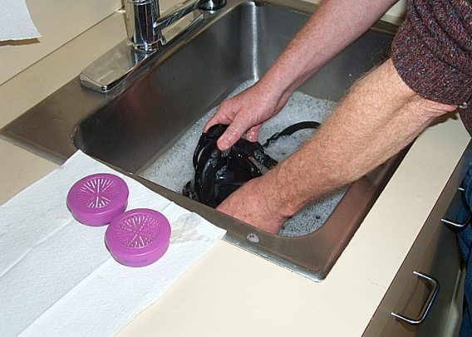
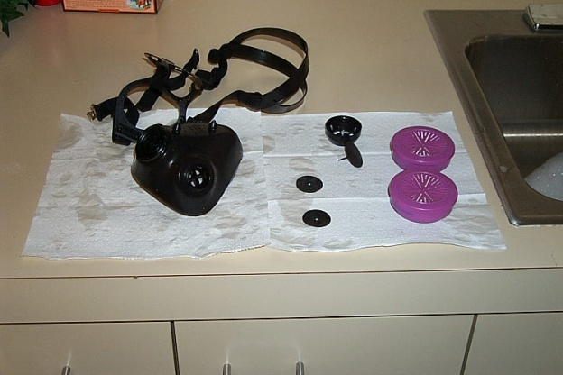
Maintenance and Care
Wash after each use
Inspect for defects before and after each use
Replace worn parts
Repair if necessary
Storage

Slide 34
Wash after each use
Wash components in with a mild detergent or warm (43°C/110°F maximum) water with a cleaner recommended by the manufacturer.
A soft bristle (not wire) brush may be used to facilitate the removal of dirt.
Rinse components thoroughly in clean, warm (43°C/110°F maximum), preferably running, water.
Drain the parts to remove excess water.

Slide 35
Maintenance and Care
Inspect each respirator before and after wearing.
Clean and dry respirators before storing.

Slide 36
Inspection Points
Check for worn or frayed Straps & Hoses.
Look for wear or damage on the seal of the facepiece.
Be sure all the screws are tight.
Check rubber and plastic parts for flexibility.
Valves should be clean and seated perfectly.
Check for cracks or deformities in the face shield.
Check condition of filters, cartridges or canisters.
Damage to speaking diaphragm, if there is one.

Slide 37
Respirator Storage
How Should Respirators be Stored?
Respirators must be stored in a clean dry place.
Don’t store them unprotected in your work area.

Slide 38
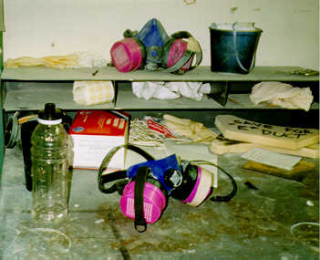
Don’t store them like this!

Slide 39
Respirator Storage
When storing a respirator, even overnight.
Flex the rubber parts to make sure they are not twisted or bent.
Seal the respirator in a plastic bag.
Store your respirator where it will be protected.
Protect the respirator from dust, sunlight, extreme heat and cold, moisture, damaging chemicals and physical damage.

Slide 40
Medical Evaluations
An initial medical evaluation is required for anyone wearing respirators.
- The first step is a confidential medical questionnaire.
- A healthcare provider decides if you need a medical exam.
Breathing through a respirator is work for the body
Respirators can be hazardous to people with heart or lung problems
Notes:
“Most people have no problem wearing a cartridge respirator. But because some people can have problems, medical evaluations are required. They start with a confidential medical questionnaire. Medical evaluations must be done before a respirator is ever used.”

Slide 41
Medical Clearance
Annual Medical Clearance Required by URS
Must be conducted by a licensed physician

Slide 42
Medical Signs and Symptoms
The following are signs or symptoms that may prevent the use of a respirator:
Seizures
Claustrophobia
Asthma
Emphysema
Pneumonia
Notes:
You should have filled out a medical evaluation form in which these items were listed. In order to be fit tested you must be passed by a licensed health care professional. This is done in order to protect you from inadvertently causing harm to yourself by wearing a respirator. If you have any of these conditions, it may be aggravated by the use of a respirator and therefore, cause you more harm than good.
Please be aware that these conditions, plus others may potentially cause you harm if wearing a respirator. Notify a health care professional immediately if you status changes as of this date.

Slide 43
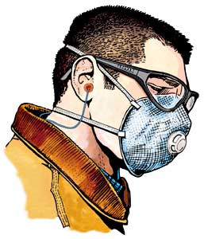
Conclusion
The respirator you use is designed to protect your health and life… but only if you use, clean and store it properly
Respirator Selection
Medical Clearance
Fit Testing
Training

Slide 44
Any Questions?

